Slide 1
Early Learning and Child Care
Quality Enhancement Grants
Purpose, Eligibility, Implementation & Reporting
WEBINAR – For Centre Directors and Boards & Home-Based Providers
Early Learning and Child Care Division
Department of Education and Early Childhood Learning
Tuesday, Feb. 28, 2023

Slide 2
Agenda
Overview of Quality Enhancement Grants
Summary of Funding Streams
Eligibility, Acceptance and Funding Disbursement
Reporting
Frequently Asked Questions

Slide 3
Quality Enhancement (QE) Grants
Purpose
The Quality Enhancement Grants provide Manitoba’s early learning and child care providers with the flexibility to choose and apply funding to where it’s needed most so they are better positioned to build a stronger, more responsive system for the future.
Targeted investments include supporting infrastructure, programming and workforce, with a goal of increasing quality child care.

Slide 4
Quality Enhancement (QE) Grants
Overview
One-time grants; four funding eligibility streams
For licensed non-profit child care centres and licensed home-based providers
Support the principles of quality, inclusivity, and sustainability.
Provides $60M in funding from Canada and Manitoba;
  $45.9M from Canada-Manitoba, Canada –Wide Agreement for eligible child care facilities with programming for children under seven
  $14M from the Manitoba Government for eligible child care facilities with programming for children 7-12

Slide 5
QE Funding Streams/ Eligibility
Summary
CENTRES & HOMES |  | CENTRES ONLY | HOMES ONLY
Quality Early Learning and Environments Grant | Enhancing Diversity and Inclusion Grant | Innovative Recruitment and Retention | Retirement Enhancement and Retention Benefit
Total Funding: $33.8M | Total Funding: 18.7M | Total Funding: $7.4M
$875 per licensed space | $500 per licensed space | $200 per licensed space | $500 one-time RRSP contribution top-up for licence holders
Coverage Period for Eligible Expenses: April 1, 2022 – March 31, 2024 |  |  | Based on 2022 tax year RRSP Contribution

Slide 6
QE Grants: General Considerations for Eligible Expenses
Flexible criteria allows facilities to select purchases specific to their unique needs.
  general expenses include professional development, equipment and materials, and small construction costs
In accepting any or all of the Quality Enhancement Grants:
  funding expenditures must be made according to the purpose and criteria of each grant funding streams: Funding Stream Guidelines
  child care facilities are expected to adhere to their organizational policies, bylaws, and exercise due diligence with any capital or leasehold improvements.

Slide 7
QE Grants: Expenses NOT Eligible
Expenses incurred prior to April 1, 2022 or after March 31, 2024
Expenses covered by another grant funding source
Gift cards, gifts, prizes, and/or incentives for participation
Staff salaries, bonuses or compensation not specifically noted in the eligibility
criteria.
Individual or centre professional memberships
Purchasing land and/or buildings
Projects or activities that generate a profit
Direct fundraising activities or events
Alcohol or cannabis related products
Purchases that do not provide benefit to staff or children
Anything not on the list of eligible items without prior written approval from the Department

Slide 8
Funding Stream Summary:
The Quality Early Learning and Environments Grant
Purpose: To make improvements to the child care facility infrastructure, equipment, and materials that will provide:
Healthy, safe learning environments
Rich learning experiences for children
Supportive work environments for staff
Welcoming spaces for families.
Amount: | $875 per space
Eligibility: | Non-Profit Centres incl. infant, pre-school, nursery, school-age programming Home – Based providers (family/group)
How to Claim: | Manitoba Child Care Search Facility Update – Deadline March 13, 2022

Slide 9
Eligible Expense Highlights:
The Quality Early Learning and Environments Grant
Purchase of equipment, delivery fees, renovations, consulting/design, professional development or other items or services authorized by the department that:
meet and/or exceed required legislation and standards
improve aesthetics
add, replace or redesign learning spaces to support children’s development
increase the variety of high quality equipment, learning materials and books
create natural outdoor learning environments
invest in technology (iPads, tablets, computers or phones) for professional development of the staff, documentation of children’s growth and development, communication with families and/or administration of the centre.

Slide 10
Eligible Expense Highlights Cont.:
The Quality Early Learning and Environments Grant
Quality second hand expenses if the items are included within the eligibility criteria. An itemized receipt must be retained.
Only 50 per cent of individual project costs for homes can be claimed for investments to the home that improve shared spaces
(space used by the home when the children are not present)
Up to 10% of the total grant funding for administrative costs to implement the grant *
Multi-sites are eligible to pool funds.
Combined/Pooled Funding Eligible with Enhancing Diversity and Inclusion Grant.

Slide 11
Funding Stream Summary:
The Enhancing Diversity and Inclusion Grant
Purpose: To improve children’s experiences through enriched curriculum rooted in the principles of diversity and inclusion that will ensure:
Improved children’s sense of belonging and meaningful program participation
Enhanced environments to better meet the needs of children and staff.
Amount: | $500 per space
Eligibility: | Non-Profit Centres incl. infant, pre-school, nursery, school-age programming Home – Based Providers (family/group)
How to Claim: | Manitoba Child Care Search Facility Update – Deadline March 13, 2022

Slide 12
Eligible Expense Highlights:
The Enhancing Diversity and Inclusion Grant
Purchase of equipment, materials, supplies, delivery fees, renovations, consulting/design, professional development or other items or services authorized by the department that:
• meet and exceed accessibility standards,
• increase accessibility to indoor and/or outdoor spaces
• enhance children’s learning centres and play materials through assistive communications technology, diverse learning tools and play materials that celebrate diversity and inclusion
• support staff development that explores educators’ beliefs and biases, cultural safety and promote secure relationships.

Slide 13
Eligible Expense Highlights Cont.:
The Enhancing Diversity and Inclusion Grant
Quality second hand expenses if the items are included within the eligibility criteria. An itemized receipt must be retained.
Only 50 per cent of individual project costs for homes can be claimed for investments to the home that improve shared spaces
(space used by the home when the children are not present)
Up to 10% of total grant funding for administrative costs to implement the grant, incl. wages*
Multi-sites are eligible to pool funds.
Combined/Pooled Funding Eligible with Quality Early Learning and Environments Grant .

Slide 14
Funding Stream Summary:
Innovative Recruitment and Retention Grant
Purpose: To advance initiatives at the child care centre aimed at building and sustaining a high quality workforce including:
Recruitment, retention and recognition of qualified ECEs and CCAs
Training and professional development of staff
Promotion of a positive organizational culture and work environment.
Amount: | $200 per space
Eligibility: | Non-Profit Centres Only incl. infant, pre-school, nursery, school-age programming
How to Claim: | Manitoba Child Care Search Facility Update – Deadline March 13, 2022

Slide 15
Eligible Expenses Highlights:
Innovative Recruitment and Retention Grant
Innovative recruitment efforts e.g. advertising vacant positions through targeted social media ads, attending/hosting careers fairs, etc.
Enrolment and/or registration fees for ongoing required training for staff e.g. First Aid and CPR, and food handlers training, etc.
Enrolment and/or registration fees to support ongoing staff professional development e.g. in-house trainings/workshops, peer mentorship training, courses.
Wages for staff training/development and/or staff replacement costs.

Slide 16
Eligible Expenses Highlights Cont.:
Innovative Recruitment and Retention Grant
Equitable, fair and transparent financial recognition of CCAs and ECEs for long service employment in a facility for a period of time. Requires
  disclosure to all employees of the centre the framework for providing the bonus (i.e. the value of the bonuses provided for what period of service).
  The long service employment bonuses must be distributed through payroll and will be considered taxable income. Payroll receipts should be retained for reporting purposes.
Up to 10% of total grant funding for administrative costs to implement the grant*
*Not eligible for combined or pooled funding.

Slide 17
Funding Stream Summary:
Retirement Enhancement and Retention Benefit
Purpose:
To provide recognition for home-based licence holders for their dedication
to the child care sector through a Registered Retirement Savings Plan
(RRSP) top-up.
Licence holders must submit the RRSP Contribution Reimbursement Application Form with their deposit receipt.
https://gov.mb.ca/education/childcare/resources/pubs/pension_rrsp_form.pdf
Amount: | $500 one-time RRSP contribution top-up
Eligibility: | Home – Based Licence Holders Only who contributed to an RRSP 2022 tax season
How to Claim: | RRSP Deposit Receipt submitted by March 15, 2023

Slide 18
Eligible Expenses Highlights:
Retirement Enhancement and Retention Benefit
Family/group child care home licence holders will be provided with an additional $500 RRSP contribution for the 2022 tax year.
RRSP contribution deposit receipts and the RRSP Contribution Reimbursement Application Form must be submitted to the Early Learning and Child Care Division by March 15, 2023.
If a licence holder in a family/group home facility made contributions to their RRSPs while on parental leave in the 2022 tax year, they are eligible to receive the Retirement Enhancement and Retention Benefit.

Slide 19
QE Grants:
Acceptance Process
 | FUNDING STREAM | How to Claim | Deadline
Centres | Quality Early Learning and Environments Grant | Accept/Decline Each MCCS Facility Update | March 13, 2023
 | Enhancing Diversity and Inclusion Grant
 | Innovative Recruitment and Retention Benefit
 | FUNDING STREAM | How to Claim | Deadline
Homes | Quality Early Learning and Environments Grant | Accept/Decline Each MCCS Facility Update | March 13, 2023
 | Enhancing Diversity and Inclusion
 | Retirement Enhancement and Retention Benefit | Deposit Receipt and Form for 2022 contribution | March 15, 2023
Grant funding distributed in one lump sum by April 14, 2023
Fund letter and pay advice will itemize amount
All grant funding received by a child care facility must be expended by March 31, 2024

Slide 20
QE Grants:
Acceptance Process - Manitoba Child Care Search
To confirm ACCEPTANCE :
Link to your facility update profile from the MCCS email
Scroll to / click on section titled “Quality Enhancement Grants”
Review the ‘Guidelines’ for each grant, and the terms and conditions of acceptance
Upon reading all information provided, you will be ready to select the grant(s) you would like to accept and/or decline.
Facilities are required to ‘accept’ or ‘decline’ each funding stream.

Slide 21
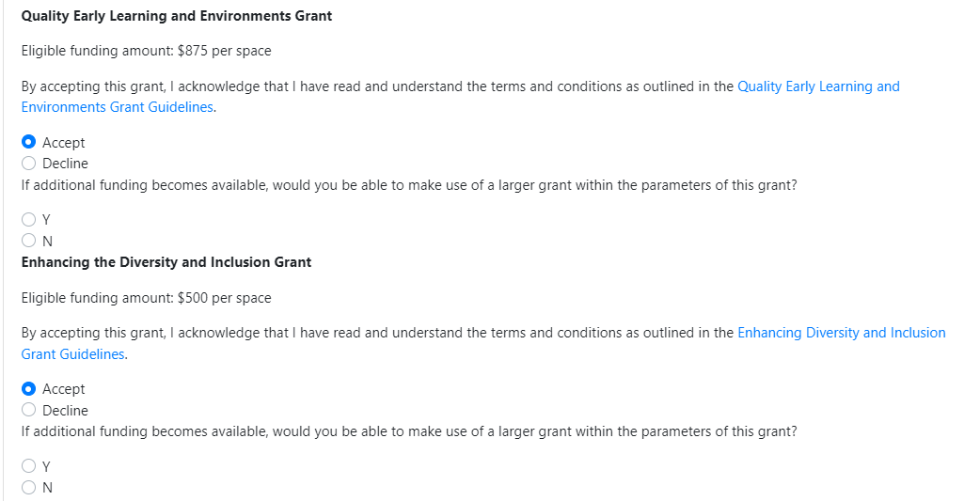

Slide 22
QE Grants:
Reporting
Interim financial and program report - Sept. 1, 2023.
  Expenditures: April 1, 2022 to July 31, 2023
  Plan to expend fund by March 31, 2024
Final financial and program report – June 30, 2024
  Expenditures: April 1, 2022 to March 31, 2024
  Plan to expend fund by March 31, 2024
Retain receipts for purchases made for review and/or audit purposes.
Reporting guidelines will be distributed early spring 2023 to provide further information about how to submit your Quality Enhancement Grants report

Slide 23
General FAQs

Slide 24
What happens if I miss the deadline?
To allow for efficient processing of payments, acceptance of grants
MUST be indicated in MCCS by the deadline of March 13, 2023.

Slide 25
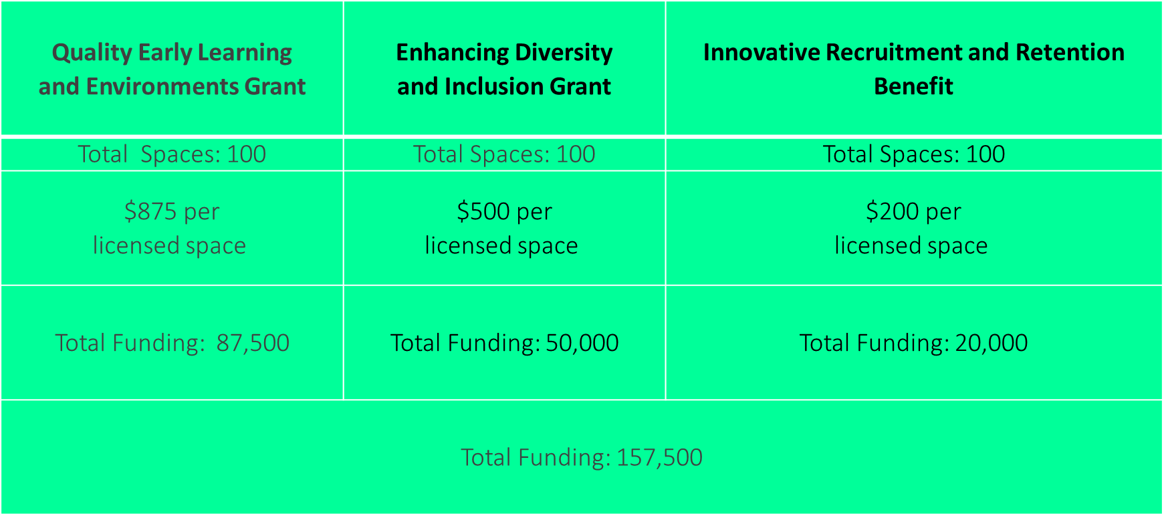
How will I know how much funding my facility will receive?
All eligible facilities will receive the set amount for each of the grants.
A funding letter will be sent out to each facility with the funding breakdown for the grant(s) that were accepted.

Slide 26
Can I submit previous expenses for reimbursement?
Yes! You can submit for:
All eligible expenses previously purchased between
April 1, 2022 and March 31, 2023 and
All eligible expenses purchased between
April 1, 2023 and March 31, 2024.

Slide 27
Can I combine funding from more than one grant?
Yes! To support larger purchases or fully fund a larger project, you may combine approved funding streams for the Enhancing Diversity and Inclusion Grant and the Quality Early Learning Environments Grant.
For example, facilities may combine funding from the grants to build a ramp to make the facility wheelchair accessible.

Slide 28
I am applying on behalf of a multi-site organization. May I pool funds from multiple sites to fund a more ambitious project at one site?
Yes! Each site (physical location) is eligible for the grant based on the number of licensed spaces at that site.
To help improve quality for all children, families and staff, you are encouraged to use the grant to support site-specific quality enhancement initiatives.
The Recruitment and Retention Grant is not eligible for pooled funding.

Slide 29
Can I spend the grant on administrative costs?
Up to 10% of the total grant can be used towards administrative costs to implement the grant(s).
Administrative cost may include:
Wages for administrative staff to develop and plan initiatives, purchase items, and complete reports – NOT APPLICABLE TO HOMES
Audit fees incurred as a result of this funding.

Slide 30
QUESTIONS & ANSWERS
More information about the Quality Enhancement Grants, including funding streams and guidelines can be found at: www.Manitoba.ca/childcare
For additional inquiries, email cdcinfo@gov.mb.ca
with the subject line “Quality Enhancement Grants”
or call Child Care Information Services at 204-945-0776
or toll-free: 1-888-213-4754.
Manitoba Child Care Search
Phone: 204-945-0776, Toll Free: 1-888-213-4754
Email: mbchildcaresearch@gov.mb.ca

