Slide 1
Budgeting for Amalgamated Municipalities February, 2016

Slide 2
Overview
Fundamentals of Municipal Budgeting
Making Budget Decisions
Budget Template for 2016
Frequently Asked Questions
Presenting the Budget

Slide 3
Fundamentals of Municipal Budgeting

Slide 4
Purpose of the Budget
Reflects Council’s objectives and priorities
Allocates resources to provide programs and services
Provides for expenditures and sets municipal tax rates

Slide 5
Budgeting-Roles and Responsibilities
Council
Set objectives and priorities
Makes decisions on services and service levels
Focus on the municipality and its citizens needs
CAO
Prepares preliminary budget based on initial discussions
Translate Council’s priorities into clear options providing analysis and implications

Slide 6
Components of the Budget
General operating fund
Utility operating fund
Capital budget - current year
Capital Program 5-year projection

Slide 7
Making Budget Decisions

Slide 8
Framework for Budget Decisions
The Municipal Act
Amalgamation Regulation
Provides transitional tools (differential mill rate, LUDs)
Time limited
Special services, Local improvement
Tools to allocate costs
Goal – equitable tax structure

Slide 9
Considerations for Budget Decisions
Applying these tools in the delivery of services in your community, consider:
Level and cost of services
Who receives/accesses services
How to apportion costs
Impact on ratepayers

Slide 10
Purpose of Transitional Tools
Provides for allocation of revenues / expenditures by special area
Manage tax shifting
Considerations for 2016
Pace of shifting to an equitable tax structure
Reassessment

Slide 11
Budget Template for 2016

Slide 12
2016 Budget Template Changes
New subpages to report last years’ budget and actual numbers per special area / LUD
Page 9 Part 1
Deletion of Grant-in-lieu (GIL) listing
Addition of Reserve Transfers
Other changes
Transportation expenditures all on Page 5
Utility budgets on Page 10

Slide 13
New Subpage 1A
Summarizes Budget and Actual figures for special areas and At-large
Automatically:
Populated by subpages 2A-7A
Carried forward to Page 1
Tax Levy & GILs must be entered manually

Slide 14
New Subpage 1A

Slide 15
Page 1

Slide 16
New Subpages 2A-7A
Details Budget and Actual results for each special area and At-large for prior year on a line item basis
Automatically carried forward to:
Subpage 1A, Page 1
Previous year’s Budget and Actual columns on Pages 2-7

Slide 17
New Subpages 2A-7A

Slide 18
Pages 2-7

Slide 19
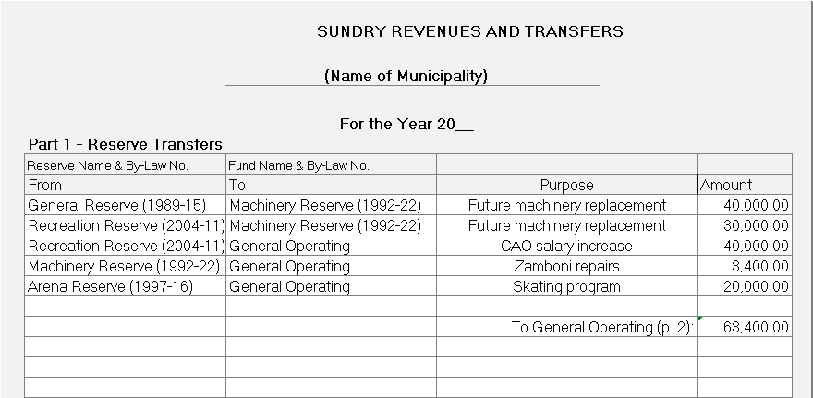
Reserve Fund Transfers
Page 9, Part 1 must report:
Transfers between Reserve funds
Using Reserve funds for non-capital purposes

Slide 20
Frequently Asked Questions

Slide 21
Debenture and Special Service Levies
Debenture and special service levies MUST be reported under the “At large” column in the general operating budget on Page 7
All debenture debt and special service levies remain with and are taxed on the specific properties on Page 8

Slide 22
Debenture and Special Service Levies - examples
Ex: $90k fire protection, $45k assessment and $45k per parcel
Ex: $48k debenture, $38k assessment and $10k per parcel

Slide 23
Debenture and Special Service Levies – p. 8

Slide 24
Grazing Lease and Converted Fees
Enter assessments for grazing leases and converted fees under the proper school division on Page 8
The revenue allocation to the School Division(s) is automatically calculated:

Slide 25
Grazing Lease and Converted Fees
Grazing lease and trailer park revenue should be reported in “At-large” column on Page 2:

Slide 26
Grazing Lease and Converted Fees
School Division portion of grazing lease and/or converted fee revenue is automatically carried forward to Page 1and deducted from Municipal Revenue:

Slide 27
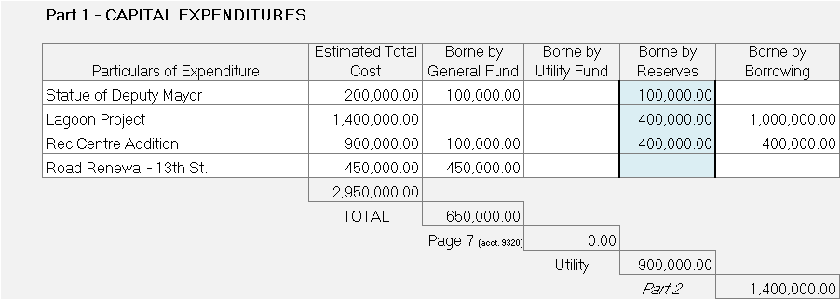
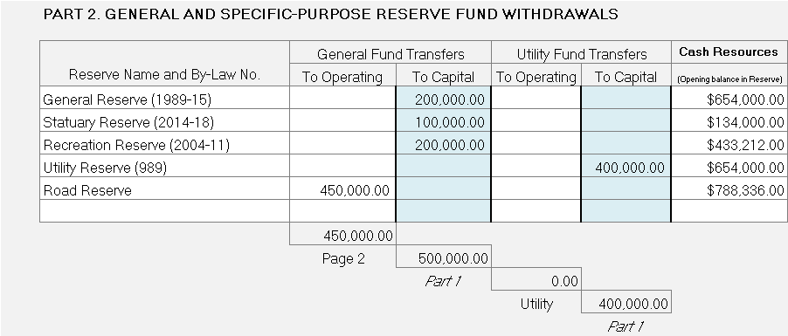
Capital Budget - Page 13
Part 1 MUST report all anticipated Capital Projects (Purchases) for the current year – estimated costs and funding source amounts.
Part 2 MUST report all transfers from Reserves to fund projects

Slide 28
Presenting the Budget

Slide 29
Effective Budget Presentations
Present goals and priorities of Council
Summarize key points
Service changes
Tax levels
Reserves and Debt
Use presentation tools
Opportunities for questions

Slide 30
Questions?
Guidelines to assist amalgamated municipalities in preparing the budget are available on MMO at:
https://web22.gov.mb.ca/mao/mmo/pdf/muni_amalg_fin_guidelines.pdf
If you have any questions, please contact a Municipal Services Officer:
Winnipeg Office: (204) 945-2572
Brandon Office: (204) 726-6571

